Slide 1
Principal-agent solutions and risk

Slide 2
Principal-agent solutions and risk
Why don’t all jobs use performance-based incentives (PBIs)?
  One barrier: risk
Attitudes towards risk
  Individuals tend to be risk averse
  Must be paid a “risk premium”

Slide 3
Principal-agent solutions and risk
Safe Job Pays | Risky Job Pays |  | Graduate's Preference
€ 100,000 | € 40,000 | with probability 1/2 | Safe job
 | € 160,000 | with probability 1/2
€ 99,000 | € 40,000 | with probability 1/2 | Safe job
 | € 160,000 | with probability 1/2
€ 90,000 | € 40,000 | with probability 1/2 | Safe job
 | € 160,000 | with probability 1/2
€ 80,000 | € 40,000 | with probability 1/2 | Indifference
 | € 160,000 | with probability 1/2
€ 70,000 | € 40,000 | with probability 1/2 | Risky job
 | € 160,000 | with probability 1/2

Slide 4
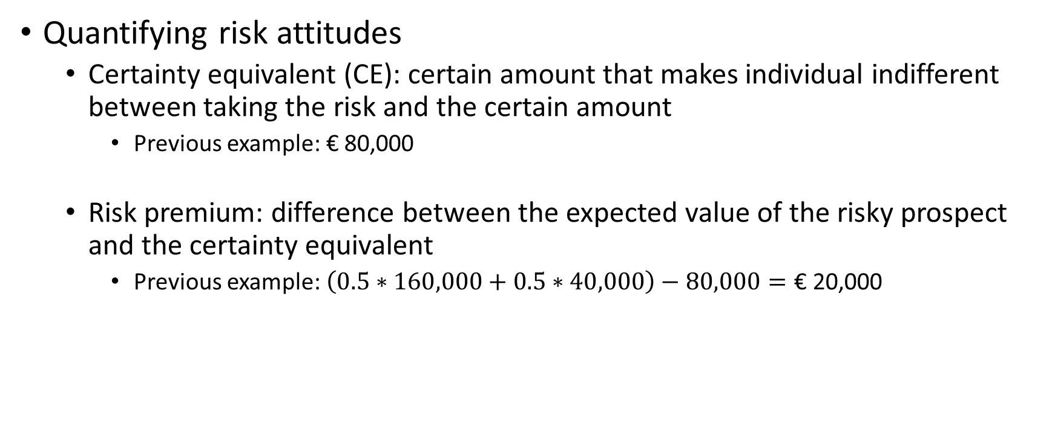
Principal-agent solutions and risk
Quantifying risk attitudes
  Certainty equivalent (CE): certain amount that makes individual indifferent between taking the risk and the certain amount
    Previous example: € 80,000
  Risk premium: difference between the expected value of the risky prospect and the certainty equivalent
    Previous example: $\left(0.5∗160,000+0.5∗40,000\right)−80,000=\text{€ }\text{2}\text{0,000}$

Slide 5

Principal-agent solutions and risk
How does model change with risk?
  $sales=\text{(}\text{€}100e)+ε$
  $E\left(ε\right)=0$, $Var\left(ε\right)=σ^{2}$
  Intuition: sales depend on effort, but also luck
    Weather, number of customers, etc.
  $wage=F+α∗sales$
Salesperson is risk averse
  $CE\left(wage\right)=E\left(wage\right)−(\frac{1}{2}×ρ Var(wage))$
  $ρ$: risk aversion parameter
The agent’s utility function is now:
  $utility=CE(wage)−c\left(e\right)$
  $F+α\left(100e\right)−\frac{1}{2}ρα^{2}σ^{2}−\frac{1}{2}{\left(e−40\right)}^{2}$
  Risk premium: $\frac{1}{2}ρα^{2}σ^{2}$

Slide 6

Principal-agent solutions and risk
What is optimal commission rate now?
  $ρ=3;Var\left(ε\right)=\text{€}10,000$
  Reservation wage = $\text{€}1,000$
  As $α↑$, effort $↑$, but costs & risk premium $↑$
Commission | Effort | Effort | Risk | Expected | Salary | Revenue | Profit
Rate | Level | Costs | Premium | Commission
0% | 40 | 0 | 0 | 0 | € 1,000 | € 4,000 | € 3,000
10% | 50 | 50 | 150 | 500 | € 700 | € 5,000 | € 3,800
20% | 60 | 200 | 600 | 1,200 | € 600 | € 6,000 | € 4,200
25% | 65 | 312.5 | 937.5 | 1,625 | € 625 | € 6,500 | € 4,250
30% | 70 | 450 | 1,350 | 2,100 | € 700 | € 7,000 | € 4,200

Slide 7
Principal-agent solutions and risk
Wrap up
  Risk aversion is a barrier to PBIs
  PBIs can improve effort, but agents must be compensated for risk
  One reason why we don’t see 100% PBIs

